Slide 1
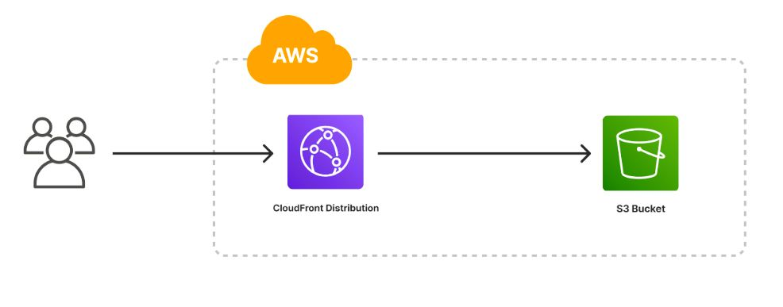
Deploy a static website on AWS S3

Slide 2
TABLE OF CONTENT :
Introduction – My daily routine project
Objectives
Tools and Technologies used
Website Description
hosting process of AWS S3
Project output description
Conclusion

Slide 3
INTRODUCTION – MY DAILY ROUTINE PROJECT
The project "My Daily Routine" is a basic static website that displays my everyday schedule in a clean, structured, and digital format. The purpose of this project is to:
Present my routine in an organized way.
Learn the fundamentals of web development using HTML and CSS.
Understand how to host a static website on Amazon Web Services (AWS) S3.
A static website means that the content is fixed it doesn't change automatically or interact with databases. It is ideal for simple websites like portfolios, resumes, and daily planners.

Slide 4
OBJECTIVES :
The objective of this project is to:
Create a personal website showing my daily routine.
Use only front-end technologies (no backend).
Deploy it online using AWS S3.
Make it accessible to anyone via a browser.

Slide 5
TOOLS & TECHNOLOGIES USED :
HTML: To build the structure of the website.
CSS: To design and style the content.
AWS S3: To host and deploy the static site.
Browser: To view and test the output.
VS Code / Notepad++: For writing and editing the code.

Slide 6
WEBSITE DESCRIPTION :
The website is a single-page site that contains different sections based on the parts of the day:
Morning Section:
Shows activities like waking up, exercising, breakfast, and getting ready.
Afternoon Section:
Covers college time, lunch, and short rest.
Evening Section:
Includes homework or study time, playtime, and other hobbies.
Night Section:
Covers dinner, light reading or revision, and bedtime.
Each section is clearly marked and styled with headings and lists to keep the content neat and readable.

Slide 7
HOSTING PROCESS OF AWS S3 :
To make the website live and accessible through the internet, I hosted it using Amazon S3 (Simple Storage Service). The steps involved were:
1. Create a Bucket on AWS S3 with a unique name.
2. Disable Public Access Blocking to allow users to view the site.
3. Upload Website Files, like HTML and CSS.
4. Enable Static Website Hosting in bucket properties.
5. Set Permissions so that everyone can access the site publicly.
6.Copy the endpoint URL and open it in the browser to view the site live

Slide 8
PROJECT OUTPUT DEESCRIPTION :
When the website is opened in a browser:
The main title "My Daily Routine" is displayed at the top.
The page is divided into four sections: Morning, Afternoon, Evening, and Night.
Each section lists the related activities in order.
The design is kept clean with soft colors and spacing to improve readability.
The website is accessible to anyone through the S3 bucket's public URL.

Slide 9
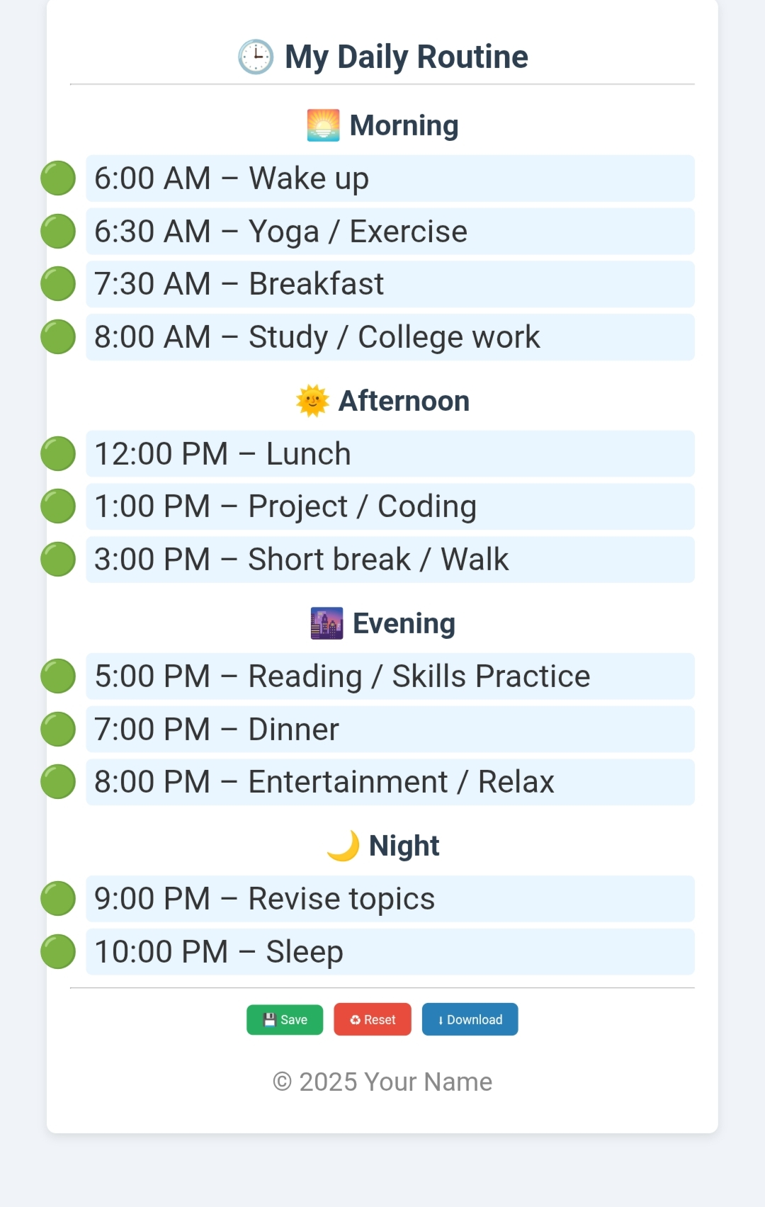
LIKE THIS:

Slide 10
CONCLUSION :
This project was a great introduction to web development and cloud deployment.
I successfully built a static website from scratch, designed it to reflect my daily routine, and hosted it on AWS S3.
It helped me understand not only technical skills like HTML/CSS and cloud hosting but also how to present real-life information in a digital way.

